Slide 1

Bahria University Karachi Campus
Data Mining
Clustering
Department of Software Engineering
Bahria University Karachi Campus
Notes:
https://www.youtube.com/watch?v=9OjRP0ZLKkk&list=PLLspfyoOYoQcI6Nno3gPkq0h5YSe81hsc&index=32

Slide 2
What is Cluster Analysis?
Finding groups of objects such that the objects in a group will be similar (or related) to one another and different from (or unrelated to) the objects in other groups
Inter-cluster distances are maximized
Intra-cluster distances are minimized
Notes:
Intra= Within, Inter= Between

Slide 3
Clustering Algorithms
K-means and its variants
Hierarchical clustering
Density-based clustering

Slide 4
Pre-processing and Post-processing
• Pre-processing – Normalize the data – Eliminate outliers
• Post-processing – Eliminate small clusters that may represent outliers – Split ‘loose’ clusters, i.e., clusters with relatively high SSE (Sum of Squared Error)

Slide 5
What Is the Problem of the K-Means Method?
The k-means algorithm is sensitive to outliers!
Since an object with an extremely large value may substantially distort the distribution of the data
K-Medoids: Instead of taking the mean value of the object in a cluster as a reference point, medoids can be used, which is the most centrally located object in a cluster
10
10
9
9
8
8
7
7
6
6
5
5
4
4
3
3
2
2
1
1
0
0
1
2
3
4
5
6
7
8
9
10
0
0
1
2
3
4
5
6
7
8
9
10

Slide 6
Cluster Validity
• For supervised classification we have a variety of measures to evaluate how good our model is
Accuracy: Accuracy is a metric that generally describes how the model performs across all classes. It is useful when all classes are of equal importance. It is calculated as the ratio between the number of correct predictions to the total number of predictions.
Precision: The precision is calculated as the ratio between the number of Positive samples correctly classified to the total number of samples classified as Positive (either correctly or incorrectly).
Recall: The recall is calculated as the ratio between the number of Positive samples correctly classified as Positive to the total number of Positive samples. The recall measures the model's ability to detect Positive samples.

Slide 7
Cluster Validity
• For supervised classification we have a variety of measures to evaluate how good our model is
Accuracy
Precision
Recall
• For cluster analysis, the analogous question is how to evaluate the “goodness” of the resulting clusters?
• But “clusters are in the eye of the beholder”!
• Then why do we want to evaluate them? – To avoid finding patterns in noise – To compare clustering algorithms – To compare two sets of clusters – To compare two clusters

Slide 8
Measures of Cluster Validity
• Numerical measures that are applied to judge various aspects of cluster validity, are classified into the following three types. – External Index: Used to measure the extent to which cluster labels match externally supplied class labels. • Entropy – Internal Index: Used to measure the goodness of a clustering structure without respect to external information. • Sum of Squared Error (SSE) – Relative Index: Used to compare two different clusterings or clusters. • Often an external or internal index is used for this function, e.g., SSE or entropy
Notes:
External Index: Compare the Clustering results to ground truth (labelled data).
Inernal: Use only data.

Slide 9
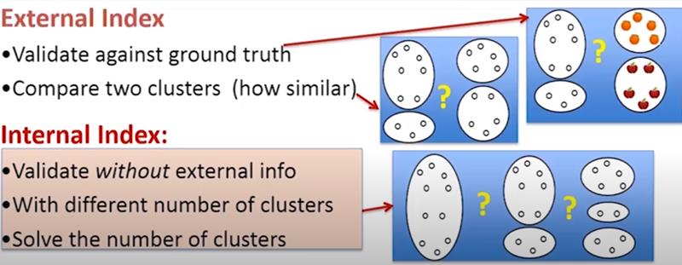
Notes:
External Index: Compare the Clustering results to ground truth (labelled data).
Inernal: Use only data.

Slide 10
Internal Measures: Cohesion and Separation
• Cluster Cohesion: Measures how closely related are objects in a cluster – Example: SSE
• Cluster Separation: Measure how distinct or well-separated a cluster is from other clusters

Slide 11
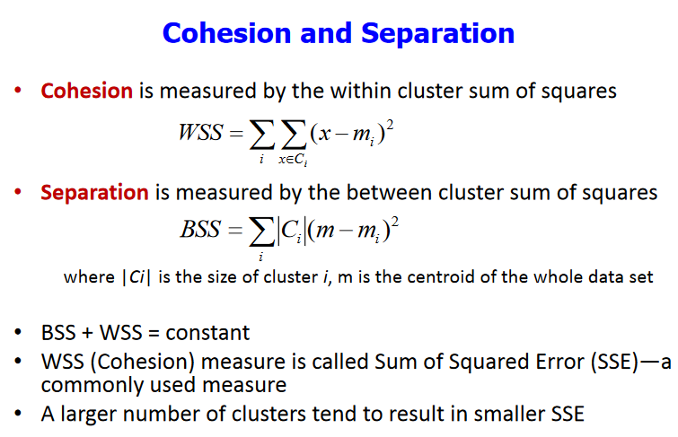
Notes:
Ci= Cluster i

Slide 12
Cohesion and Separation: Example
Example: SSE
BSS + WSS = constant
m
×
×
×
1
m₁
2
3
4
m₂
5
K=1 cluster:
K=2 clusters:

Slide 13
Internal Measures: Cohesion and Separation Cont…
A proximity graph based approach can also be used for cohesion and separation.
Cluster cohesion is the sum of the weight of all links within a cluster.
Cluster separation is the sum of the weights between nodes inside the cluster and nodes outside the cluster.
cohesion
separation

Slide 14
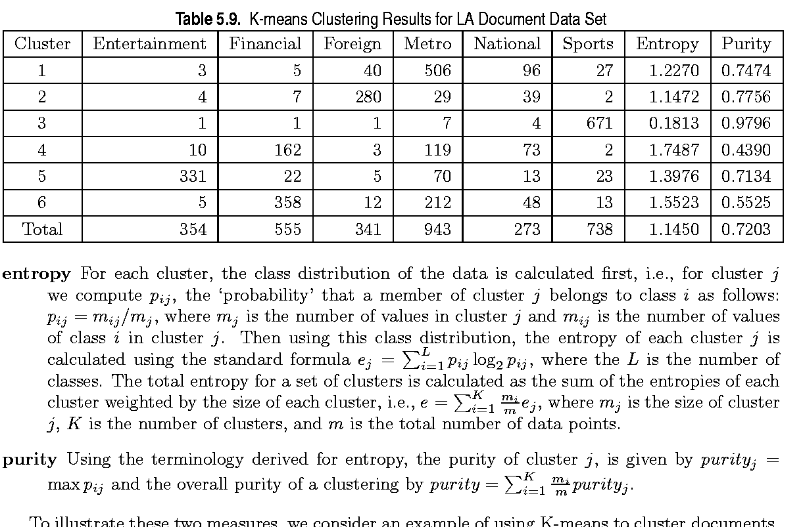
External Measures of Cluster Validity: Entropy and Purity

Slide 15
Calculation
Entrophy:
Row:[ -(3/677 log₂ (3/677) + 5/677 log₂ (5/677) + 40/677 log₂ (40/677) + 506/677 log₂ (506/677) + 96/677 log₂ (96/677) + 27/677 log₂ (27/677))]
Total: 354/3204*1.227 + 555/3204*1.1472 + 341/3204*0.1813+ ………………..(Total(column)/Total*Entropy(Row)
Purity:
Row: 506/677 (max/total)
Total: 354/3204*0.7474 + 555/3204*0.7756+ 341/3204*0.9796 + ……………….. (Total(column)/Total*Purity(Row)

Slide 16
Agglomerative clustering

Slide 17
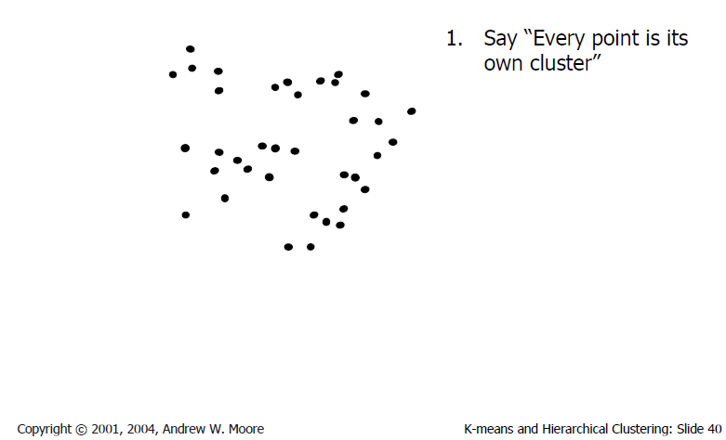
Agglomerative clustering

Slide 18
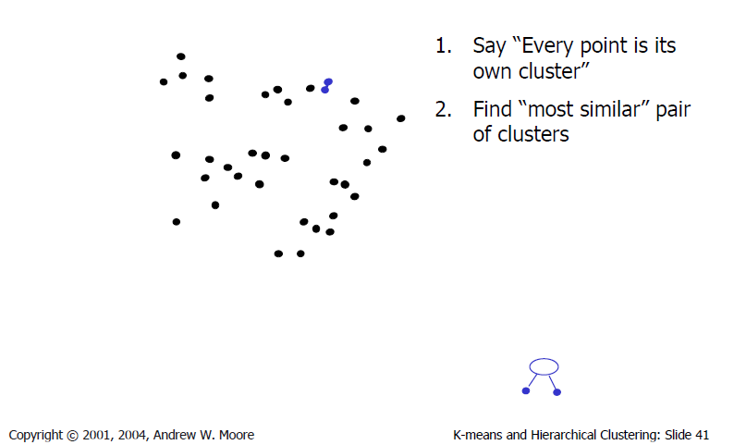
Agglomerative clustering

Slide 19
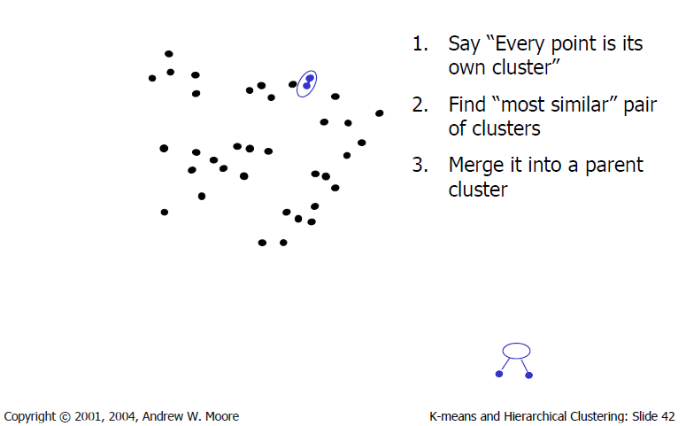
Agglomerative clustering

Slide 20
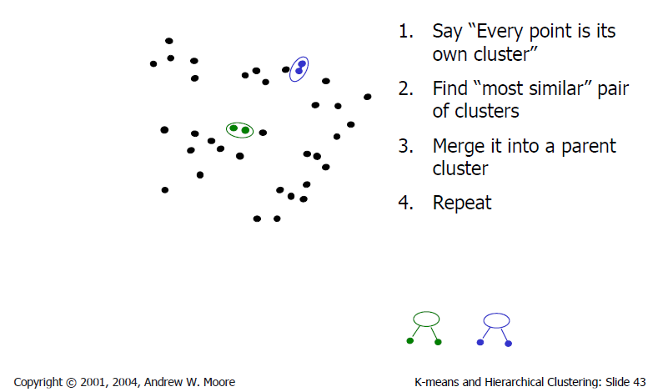
Agglomerative clustering

Slide 21
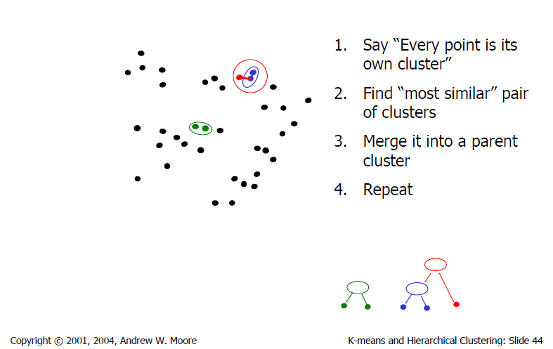
Agglomerative clustering

Slide 22
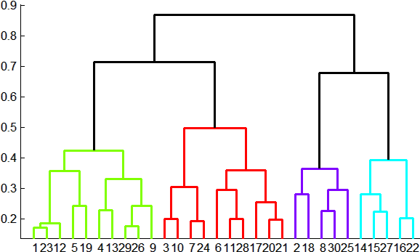
Agglomerative clustering
How to define cluster similarity?
Average distance between points, maximum distance, minimum distance
Distance between means
How many clusters?
Clustering creates a dendrogram (a tree)
Threshold based on max number of clusters or based on distance between merges
distance

Slide 23
Conclusions: Agglomerative Clustering
Good
Simple to implement, widespread application
Provides a hierarchy of clusters
Bad
May have imbalanced clusters
Still have to choose number of clusters or threshold

Slide 24
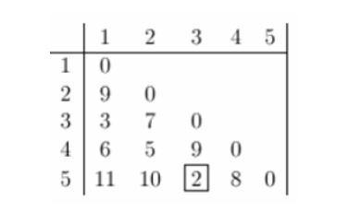
Example
Clustering starts by computing a distance between every pair of units that you want to cluster.
A distance matrix will be symmetric and will have zeroes on the diagonal (because every item is distance zero from itself).
The table below is an example of a distance matrix. Only the lower triangle is shown, because the upper triangle can be filled in by reflection.

Slide 25
The smallest distance is between three and five and they get linked up or merged first into a the cluster '35’.
To obtain the new distance matrix, we need to remove the 3 and 5 entries, and replace it by an entry "35" .
Since we are using complete linkage clustering, the distance between "35" and every other item is the maximum of the distance between this item and 3 and this item and 5. For example, d(1,3)= 3 and d(1,5)=11. So, D(1,"35")=11. This gives us the new distance matrix.

Slide 26
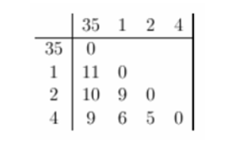
The items with the smallest distance get clustered next. This will be 2 and 4.

Slide 27
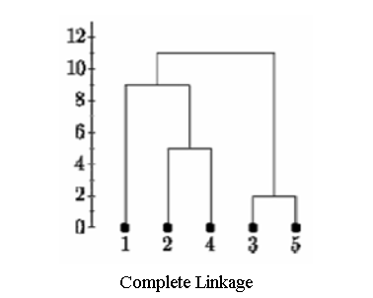
Continuing in this way, after 6 steps, everything is clustered.

Slide 28
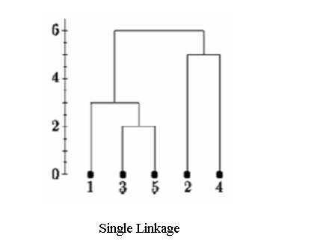
Below is the single linkage dendrogram for the same distance matrix. It starts with cluster "35" but the distance between "35" and each item is now the minimum of d(x,3) and d(x,5). So c(1,"35")=3.

Slide 29
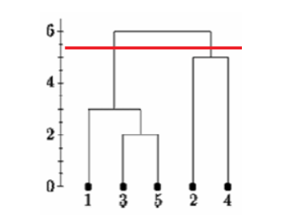
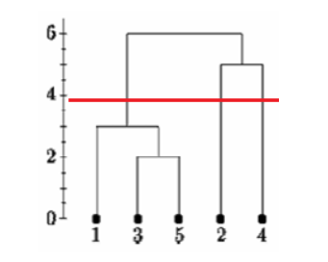
Determining clusters

